Slide 1
Building a library for parallel simulation of networking protocols
By:
Mohamed Ahmed
Abdul-Rahman Elshafei
Khalil Yonis

Slide 2
Outline
Why network simulation
Network simulation
The library
Parallel simulation
Future Considerations

Slide 3
Why network simulation
Rapid diffusion of internetworking technologies
major sources of stress to the underlying protocol architecture
  Scale
  heterogeneity

Slide 4
Network simulation
Provides means to study network traffic.
Provides a level of predictability in the network.
Some of the simulation tools available:
  NS-2
  OMNet
  OPNET

Slide 5
Parallel Simulation
Reduces the cost and time of large scale simulations
Reduces memory requirement.
A growing research area
Limitations of current tools

Slide 6
Enhancing network simulation
Network simulator built on the DEVS formalism
CD++
Modular library
  Flexible
  Generic
  Emulation of real life

Slide 7
The Library
Host
  TCP/IP stack
Router
  Table module
  Processor module
  Interface module
Hub Standalone and Parallel Model

Slide 8


The Formalism
Atomic Model
Coupled Model
X: the input events set.
S: the state set.
Y: the output event set.
δint: the internal transition function.
δext: the external transition function.
I: the output function.
D: the duration function.
I: the models interface.
X the input event set;
Y the output event set;
D the index of the components of the coupled model; and ∀ i ∈ D,
Mi is the a basic DEVS (an atomic or coupled model);
Ii is the set of influences of model iand ∀ j ∈ Ii ,
Zij is the i to j transition functions.

Slide 9
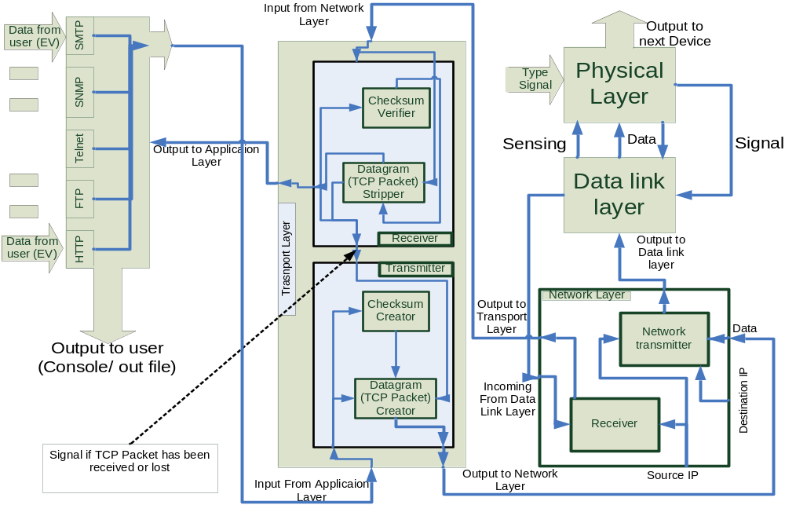
Host

Slide 10
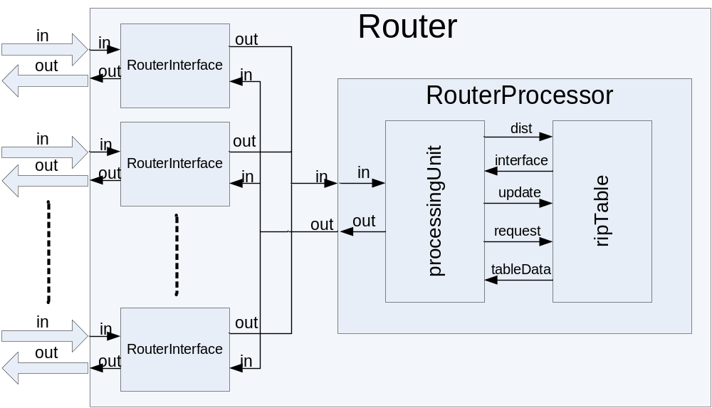
Router

Slide 11
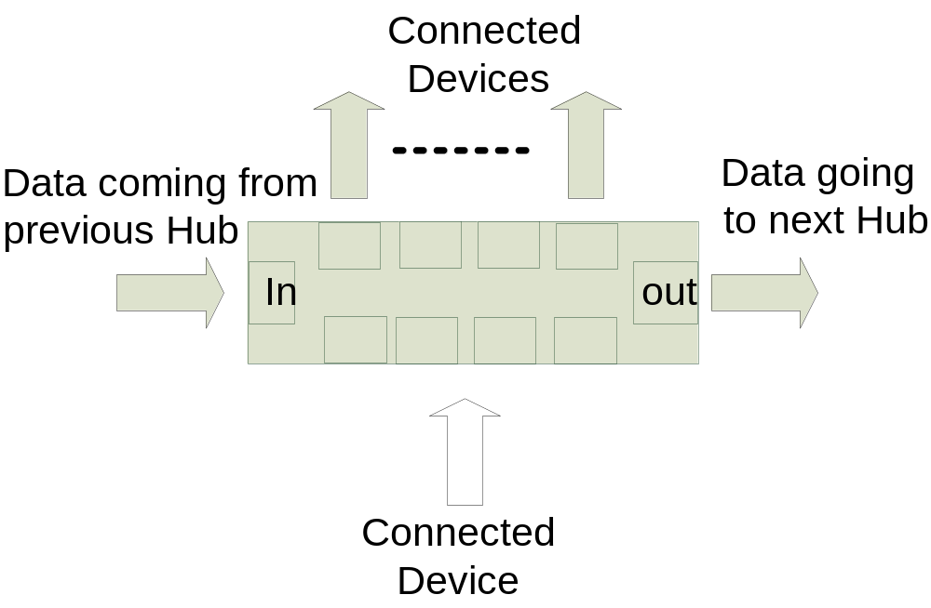
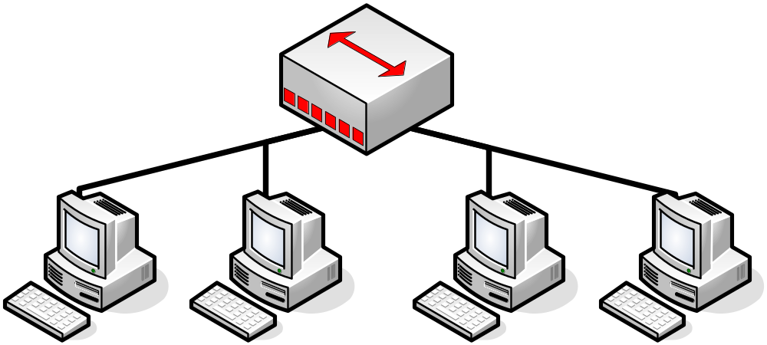
Hub

Slide 12
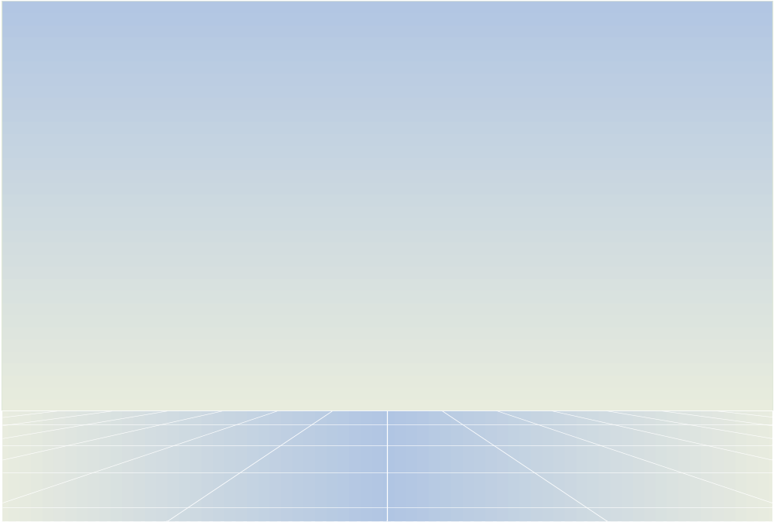
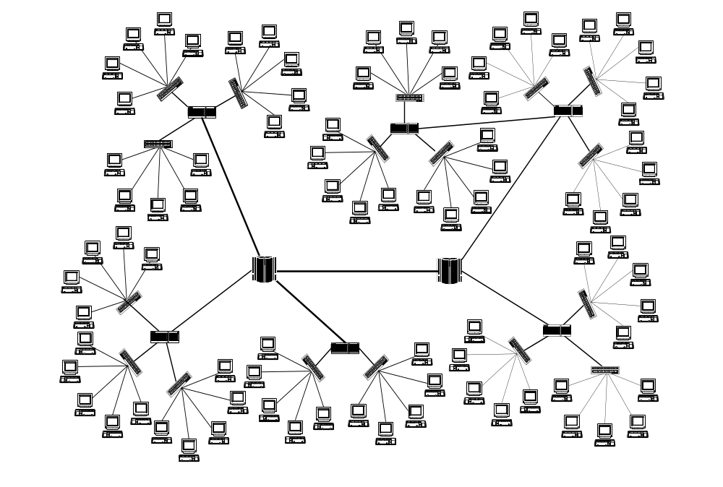

Slide 13
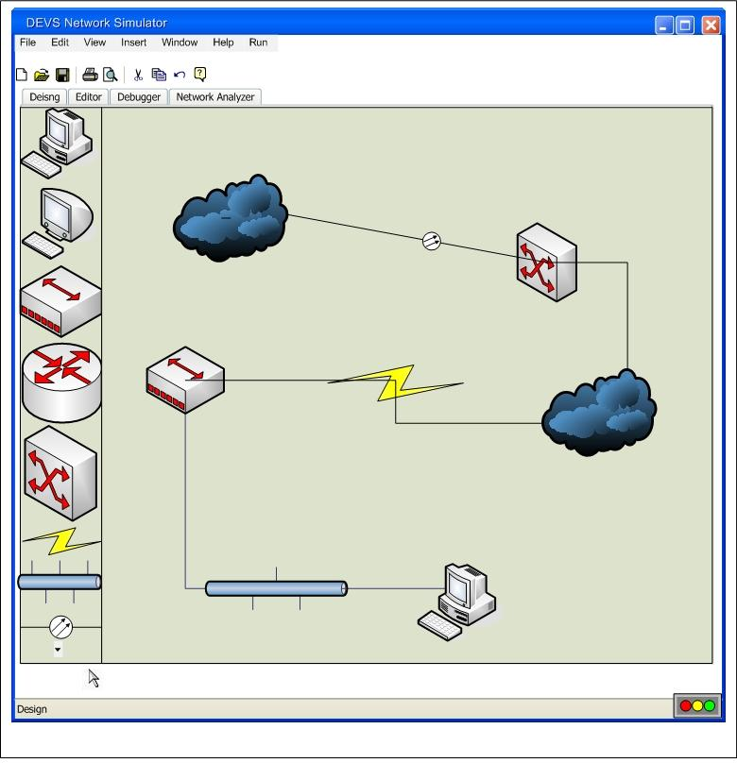
Future Considerations
Model File maker
Enhancing the library
Converting remaining models into a parallel environment

Slide 14
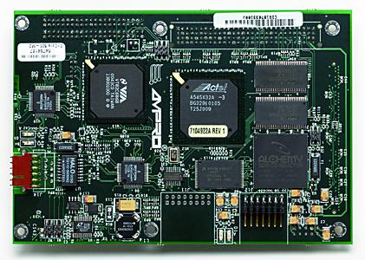
Network Prototyping
Real time simulation on embedded linux microcontrollers
Rapid design and testing potential network devices

Slide 15
Conclusion
A modular library of protocols and inter-networking devices
Models are generic, and flexible to change
Interoperability with other DEVS models

Slide 16
Questions
?

Slide 17
References
[1] VINT Project, “Overview”, [online document], last updated: October 19, 1997, available: http://www.isi.edu/nsnam/vint/project_overview.html
[2]Ampro Encore 400 embedded processor, [online Document], last updated: ,available: http://www.ampro.com/html/EnCore_400.html
[3] http://www.isi.edu/nsnam/ns/ns-limitations.html

